Slide 1

Understanding Climate Change through Data Visualisation
By: Hasnain Younas
27016428

Slide 2
AIM AND PURPOSE OF THE PROJECT
Climate worsening by the year
Threatening the way we live and the future of our planet
US is the third largest country in the world
Roughly half of them believe that it is a threat to our planet
Japan

Slide 3



Different Methodologies Used
Data Mining
Data compiled in excel file
Data cleansing

Slide 4
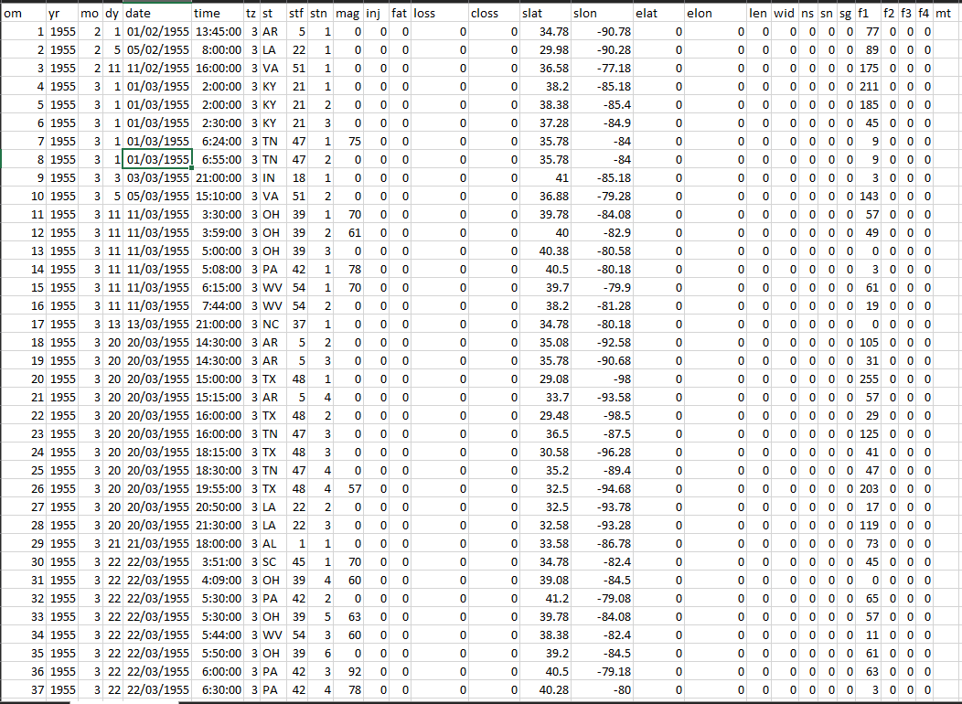
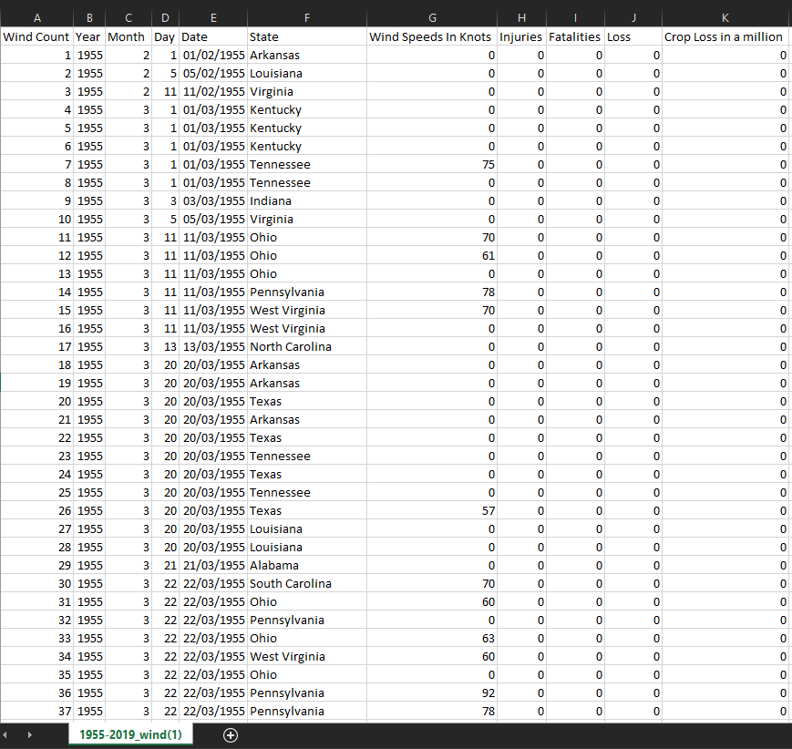
Data Cleansing
Original from source
After Cleansing

Slide 5
Implementation
Tool used: Tableau
Data sources: Severe winds, Average Temperatures Rising, Tornadoes, Hailstorm
Injuries/fatalities
Earthquake Magnitude, wind speed in knots etc implemented
Tests performed
Navigation buttons were also added into the visualisation

Slide 6
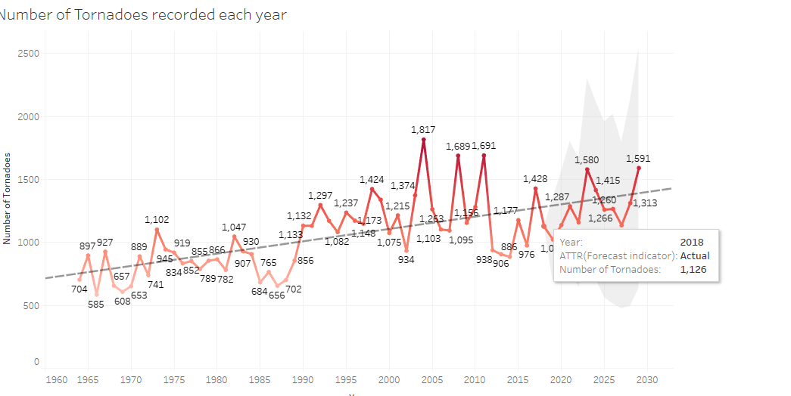
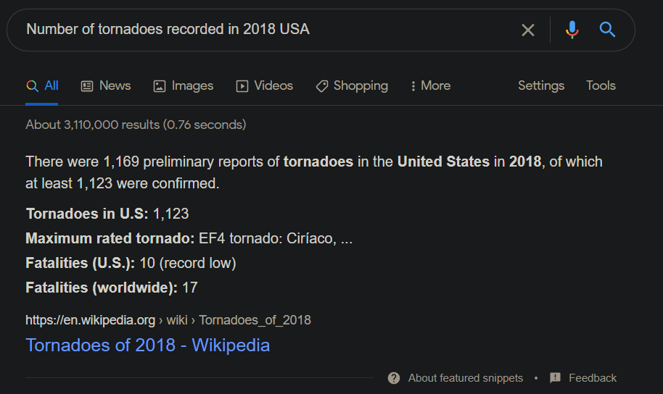
Testing data for accuracy

Slide 7
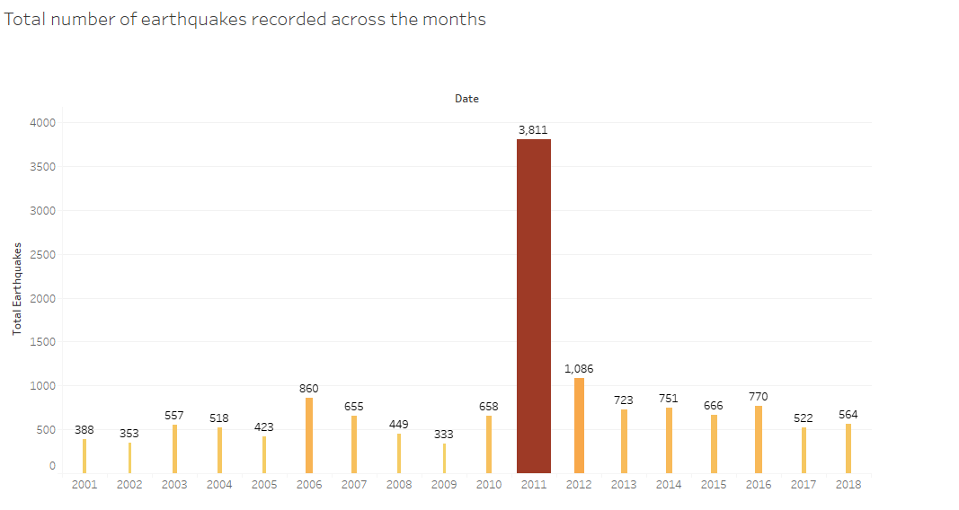
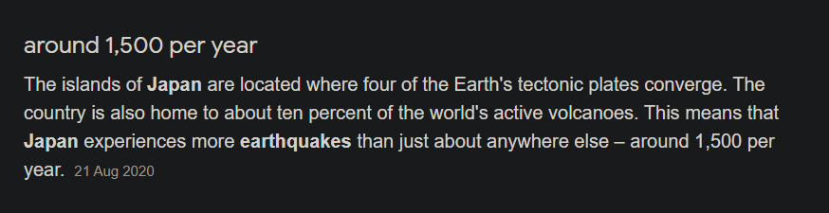
Test 2

Slide 8
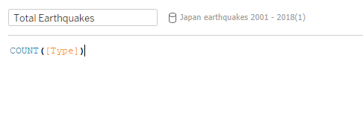
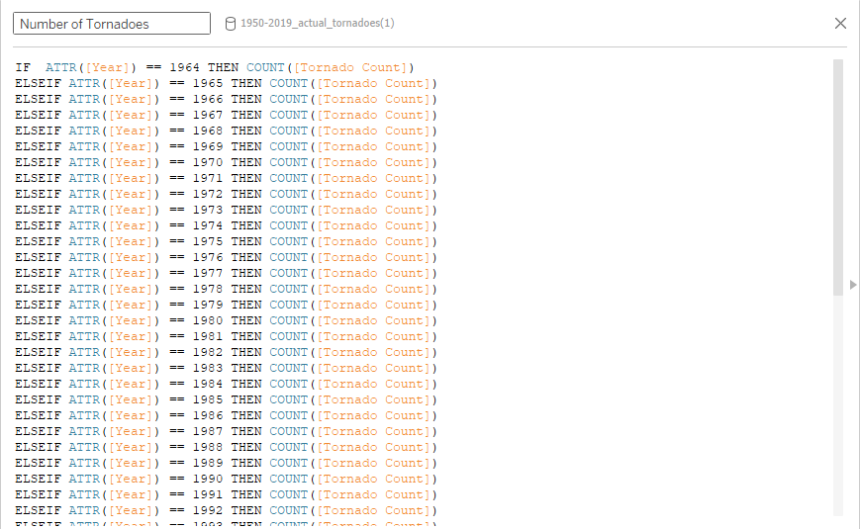
Screenshots of some calculations performed

Slide 9
Conclusion
Learned how to use Tableau
Enhanced my analytical skills and research
Change people’s thoughts
Visualisation easily understandable
Professional looking
Help organisation and data analysts

Slide 10
Thank you for listening

